Slide 1
Motion Detection with FPGAs
Group 4
Yi Qi Cao and Da Kang

Slide 2
Overview
Video capturing through HDMI
Processing of individual frames using motion detection algorithm
Sending frames to server when motion is detected

Slide 3
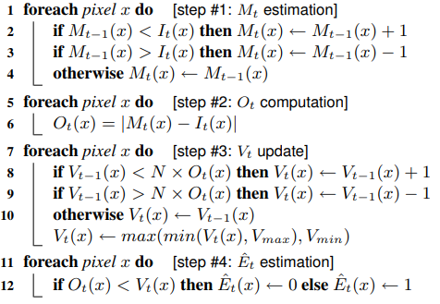
Motion Detection Algorithm
Algorithm uses “background estimators” to determine if a pixel has changed
The output is then processed to remove noise

Slide 4
Initial Goals
Completion of custom IP that implements the motion detection algorithm
Streaming video when motion is detected
Processing and streaming at a reasonable rate; several times a second at 720p resolution

Slide 5
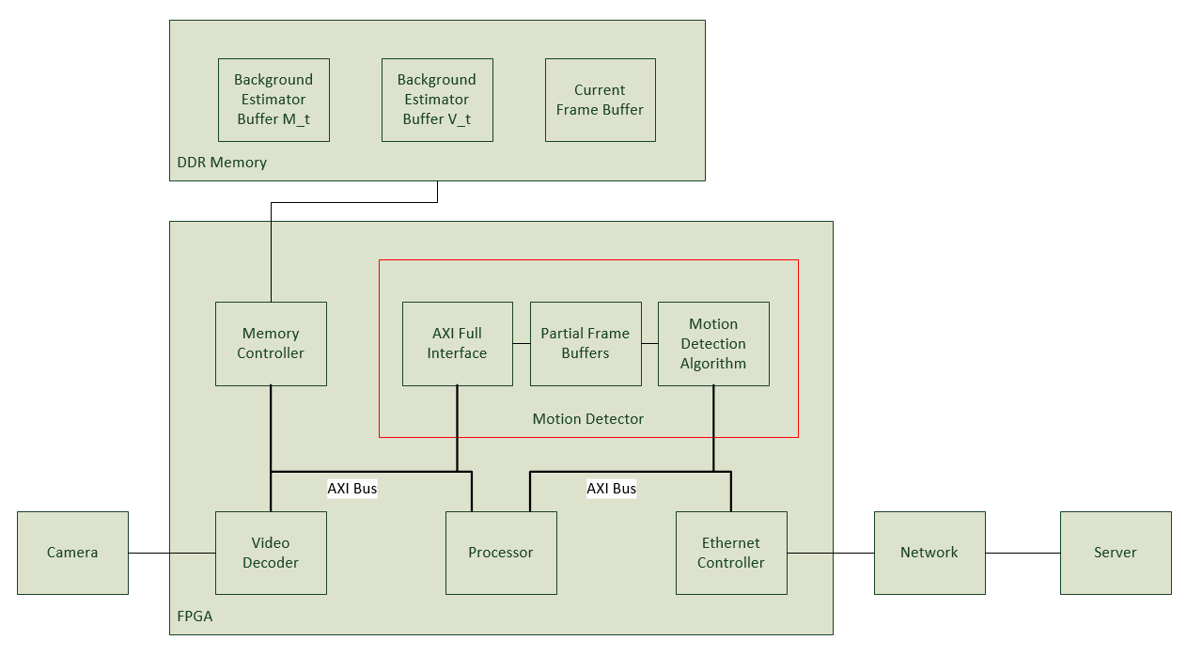
Planned Block Diagram

Slide 6
Problems
AXI lite was too slow
A 720p frame took several seconds to process due to the amount of data transferred
Attempted to use AXI full, but unsuccessful
Ended up rewriting the AXI lite interface to pack the data being transferred
Also lowered resolution to 640x480
Ethernet was unexpectedly slow

Slide 7
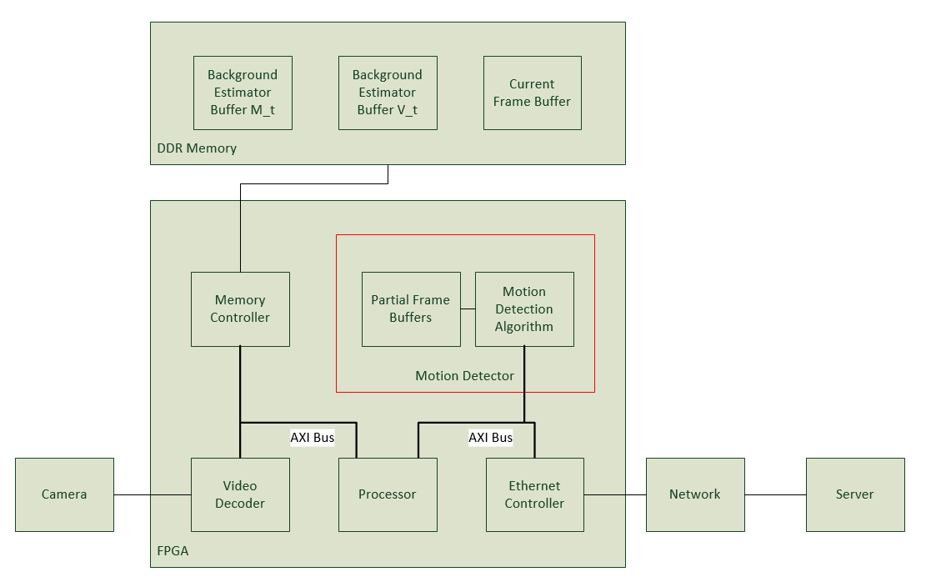
Final Block Diagram

Slide 8
Project Components
Basic block design was a combination of Digilent’s HDMI I/O and Ethernet tutorials
Custom IP was integrated into the design
Microblaze control code is partly original
Video capture control code is from Digilent
Ethernet streaming code is heavily modified from LwIP example, mostly original
Custom IP control code is original

Slide 9
Design Methodology
Managing multiple designers by assigning separate components that can be worked on in parallel
Da Kang: implementation and testing of custom IP
Yi Qi Cao: video streaming over Ethernet, custom IP integration, final integration

Slide 10
Design Methodology
Incremental testing
Create and test each part of the design separately, and incrementally combine the different parts

Slide 11
Design Methodology
Algorithm:
Algorithm is defined step by step; easy to translate to hardware
More complicated functions like abs are implemented/tested in a separate module
Each module was tested individually with a testbench
Total integration of algorithm modules was tested by itself in a testbench, compared with a Python implementation

Slide 12
Design Methodology
Custom IP containing algorithm was tested with a VIP testbench
Control code was tested after integration of custom IP into HDMI I/O example
Ethernet streaming tested separately and integrated at the end

Slide 13
What We Learned
Testing is important
In a large design, you need to know what components are working when something goes wrong
Hardware design is very slow
A full synthesis and implementation run took close to 2 hours
Important to test as much as possible before actually running in hardware

